Slide 1
Cooking Up a Plan
Roger Liu
Stephen Chen
Task Planning for the Game Overcooked

Slide 2
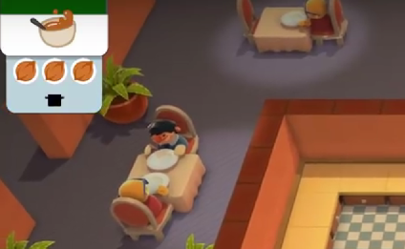
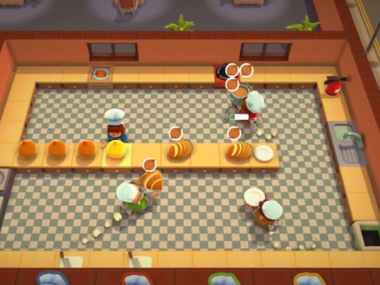
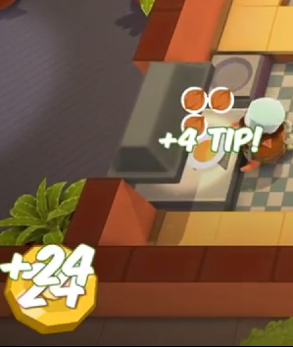
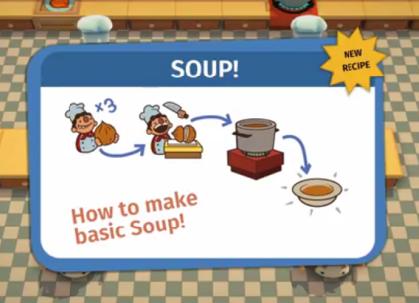
What is Overcooked?
Overcooked is a cooperative cooking game
Players control chefs and prepare meals for incoming orders in real-time.
Creating a meal following involves a series of steps.
Completing meals faster rewards more points.
Complete Meals
Follow Recipes
Get Orders
Organize Tasks

Slide 3
Related Work
Single-agent Task Planning
Kaelbling and Lozano-Perez. Hierarchical Task and Motion Planning in the Now.
Spitz and Requicha. Multiple-Goals Path Planning for Coordinate Measuring Machines.
Multi-agent Works
Arai et al. Mutli-agent Reinforcement learning for Planning and Scheduling Multiple Goals.
Kawakami and Kakazu. A Study on Robot Task Planning Problems in Multiagent Environments.
Kamel and Syed. Task Decomposition and Plan Generation in Multiagent Domains.
Wurm et. al. Coordinating heterogeneous teams of robots using temporal symbolic planning.
Wang et al. Hierarchical Task Planning for Multiarm Robot with Multiconstraint.
Notes:
Overcooked = common planning problems
Single-agent task
Order preparing ingredients for multiple goal recipes
Navigate kitchen
We see task planning in hierarchical planning
And multiple goal planning in surveyal
Multi-agent
Not our project
Reinforcement approaches
Optimal assignment of tasks
Robots of differing capabilities
Case studies in space

Slide 4
Planning Representation
Symbolic planning
Game State
State of ingredients (Onions, tomatoes, mushrooms)
State of kitchenware (cutting board, pots, plates)
etc...
Transitions: player actions
Chop up ingredient x
Add ingredient x to pot y
Goal states: recipe is completed
Cost: time steps vs reward earned

Slide 5
Approach
Create a simplified version of Overcooked as our test environment (using Unity game engine).
Use symbolic planning to have a single agent process a single order.
Use waypoint planning to handle multiple orders at a time.
Online planning
Handle orders coming in at different times
Handle the case when there are no outstanding orders
Potential Extension: Run a centralized, multi-agent planner for 2 agents

Slide 6
Metrics of Success
Speed of computing viable plans
Quality of the plan
Look at reward earned
Compared to optimal
Compared to human players
In the case of 2 agents, can the planner improve its score in a significant way

